Slide 1
Humanlytics:
Business Plan
Muhammed Arslan
Muhammed Tayyab
Dallas Diaz
Ramya Thambabattula

Slide 2
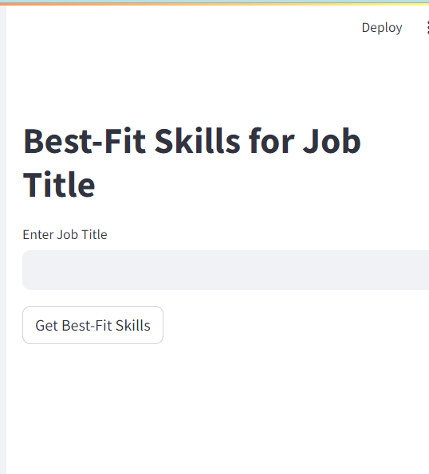
What are we offering?
Humanlytics offers a comprehensive dashboard catered to HR departments of all company types.
We cater to the evolving needs of organizations by
Focusing on:
Talent acquisition
How can we find the best of the best employees
Employee retention
Looking at factors that make employees stay
Workforce analytics

Slide 3
Understanding our diverse customer base
Business Owners
Non Profit Organizations
HR Professionals
Startup Entrepreneurs
Remote Workforce Companies
Notes:
Our emphasis is on Small business owners and HR professionals because we feel that these two make up the majority of the current market

Slide 4

How does this product solve real world problems?
Here are a few ways that Humanlytics can ease the HR pains of many businesses:
Inefficient Recruitment Processes: Humanlytics streamlines recruitment, saving time and resources for HR professionals.
Costs: Catered to Small Business Owners focusing on affordability and quick results.
Challenges in Retaining Employees: Our holistic approach to employee retention addresses the specific needs of organizations, enhancing staff satisfaction and longevity.

Slide 5

Why us?
We prioritize a personalized approach to talent acquisition, allowing us to tailor our recruitment process to each individual candidate's needs and preferences.
We leverage data-driven insights to optimize HR recruitment, ensuring that we make informed decisions that lead to successful placements and reduced turnover rates.
Our focus on a proactive approach to employee retention sets us apart in the industry, leading to higher employee satisfaction and loyalty.

Slide 6




Who are our competitors?
Traditional Talent Agencies: These organizations are more established but leave room for error in finding the best candidates
Online Recruitment Platforms: A strong competitor but these platforms miss the opportunity to understand employee satisfaction and utilizing this information to prevent turnover rates

Slide 7
Cost structure
Category | Item | Annual Cost
Salaries | HR Consultants (4) | $100,000
 | Data Analyst (1) | $50,000
Technology | Maintenance | $10,000
 | Subscriptions | $5,000
Marketing | Digital Campaigns | $20,000
 | Event Participations | $5,000
General Operations | Office Rent | $15,000
 | Admin | $10,000
Totals |  | $215,000

Slide 8
Revenue Estimates
Category | Fee | Revenue
Talent Acquisition Services | Placement fee for successful candidate hired: $1,000 Estimated Successful candidates: 50 | $50,000
Employee Retention Services | Monthly Subscription Fee per client: $500 Estimated number of clients: 20 | $120,000
Workforce Analytics Services | Quarterly Consulting Fee per client: $2,000 Estimated number of clients: 10 | $80,000
Totals |  | $250,000
Estimated Revenue: $35,000

Slide 9
Use of Funds
01
Servers
Firebase Database
Infrastructure
02
UI Designer Licenses
Streamlit
Security and Performance testing
Software and Testing
03
Social Media
PR
Events
Marketing

Slide 10
Milestones
May 2024
July 2024
October 2024
December 2024
Initial Beta Release
Official Release
First Prospective Client
Additional Funding for Expansion
Validation and Testing with students and Humanlytics Team

Slide 11
Questions?

